Slide 1
Mediating in a polarized society
David Fairman, Senior Mediator, Consensus Building Institute
Associate Director, MIT-Harvard Public disputes program

Slide 2
Overview
How have we become so politically polarized?
Where is the public today?
What are the main levers for addressing polarization?
What can mediators do?
Where do we go from here?

Slide 3
Major changes in the US since 1960
Economic: globalization, automation, capital advantages, the knowledge economy
Social: demographic shift, new social movements, more education, residential and virtual segregation
Political: two realignments of the political parties
Republicans 1960s-1990s conservative movement and Reagan coalition; 2010- populism and nativism
Democrats: 1960s-1980s end of the New Deal coalition and rise of the new Left; 1990s- multiracial coalition with centrist leadership

Slide 4
Drivers of polarization
Economic
White working class disillusioned with Democratic party
Immigration perceived as threat to jobs
Pervasive economic insecurity increases appeal of populism
Highly educated professional class becomes more progressive

Slide 5
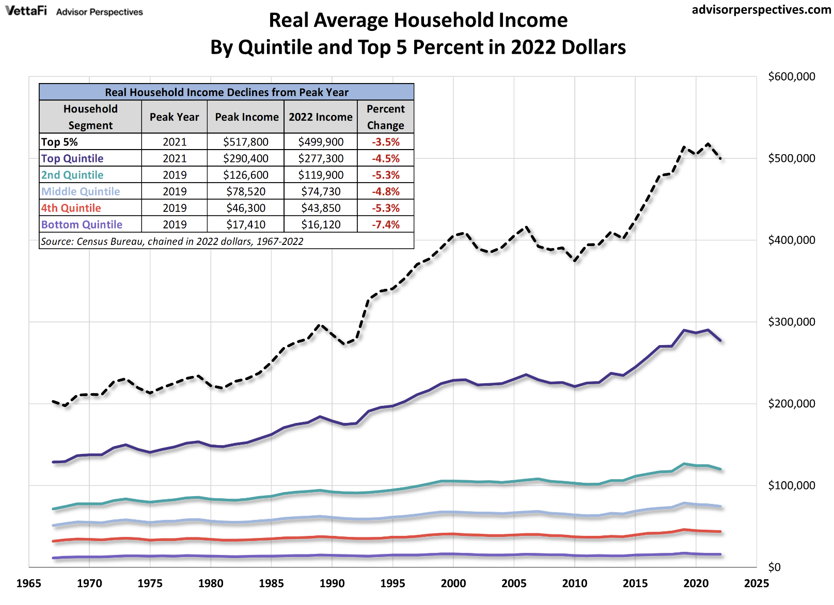
Incomes since 1967

Slide 6
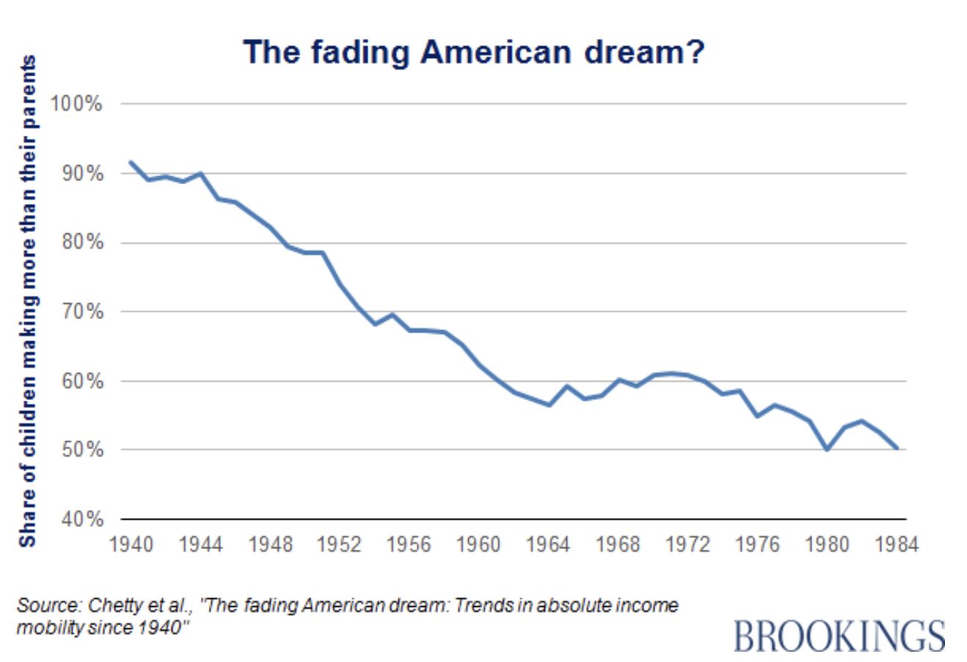
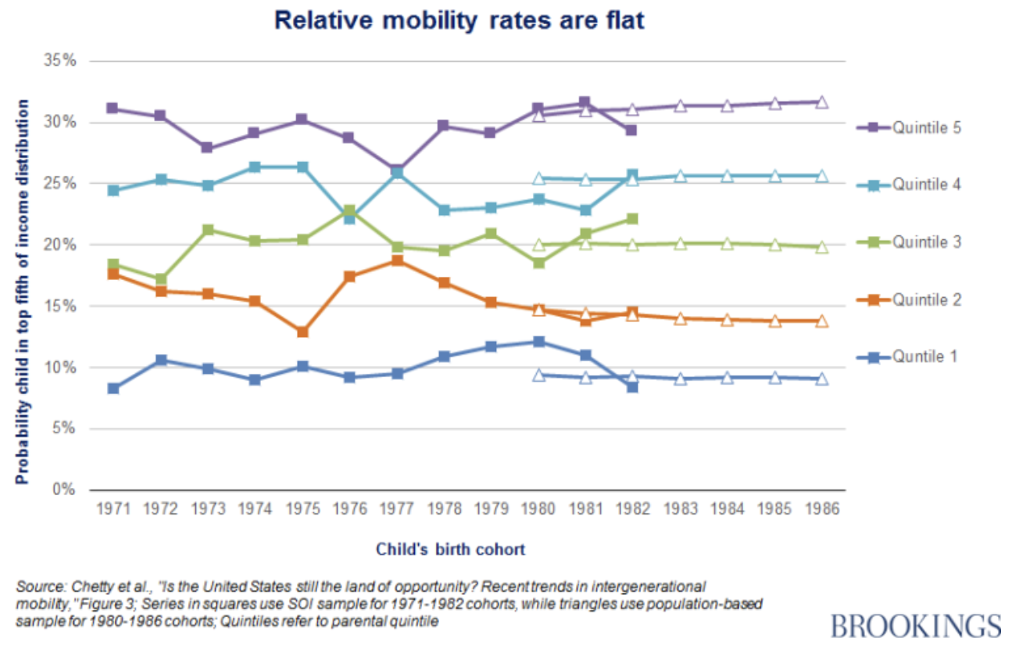
Economic mobility

Slide 7
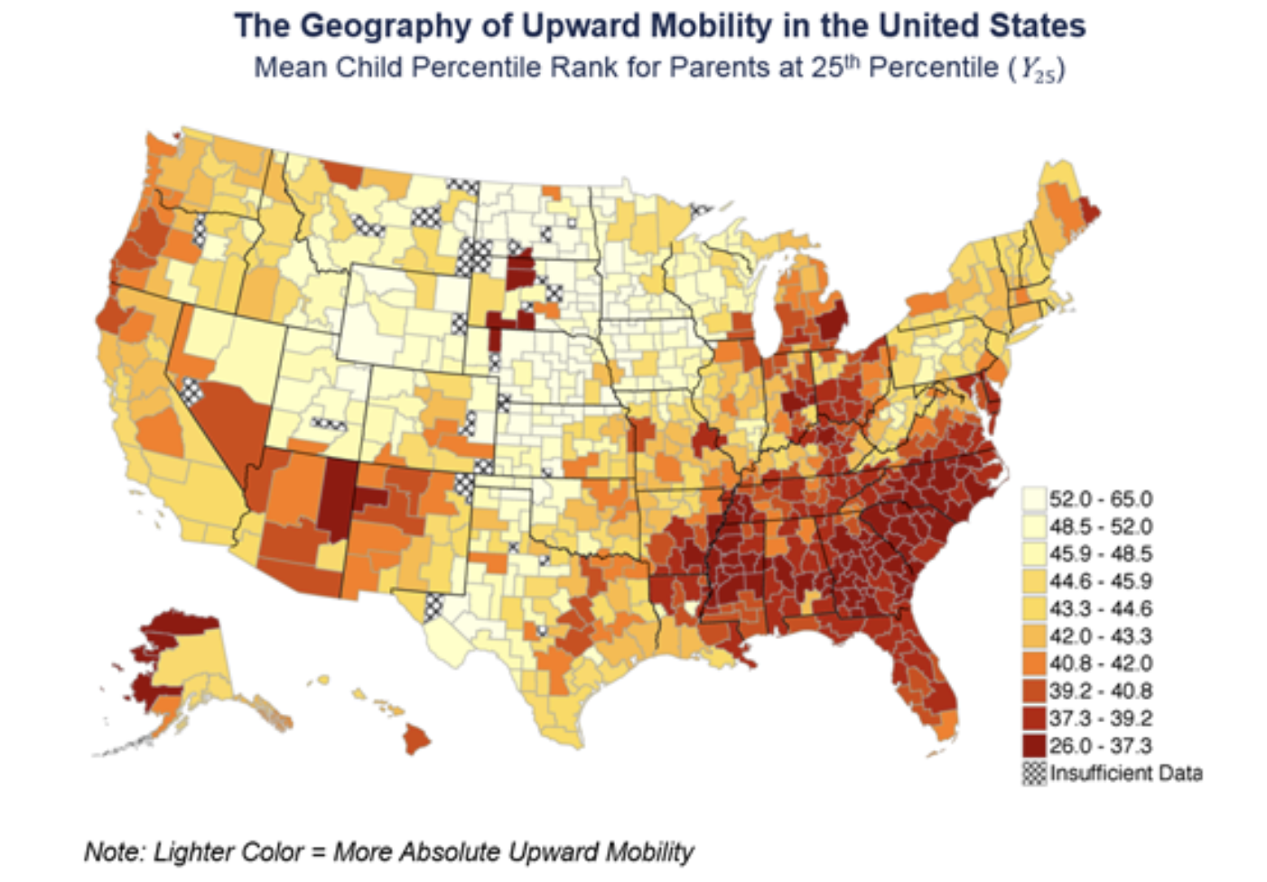
Economic mobility

Slide 8
Drivers of polarization
Social
The meritocracy becomes hereditary
Declining trust in institutions and elites
Declining civic participation
Class-, race-, and ideology-based segregation: residential and virtual
Cultural experience of large cities substantially different from towns and rural areas

Slide 9
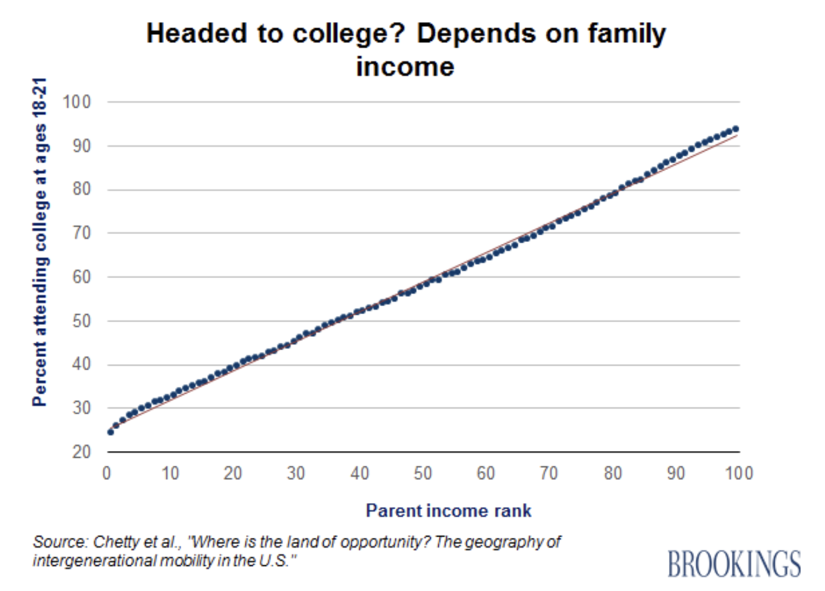
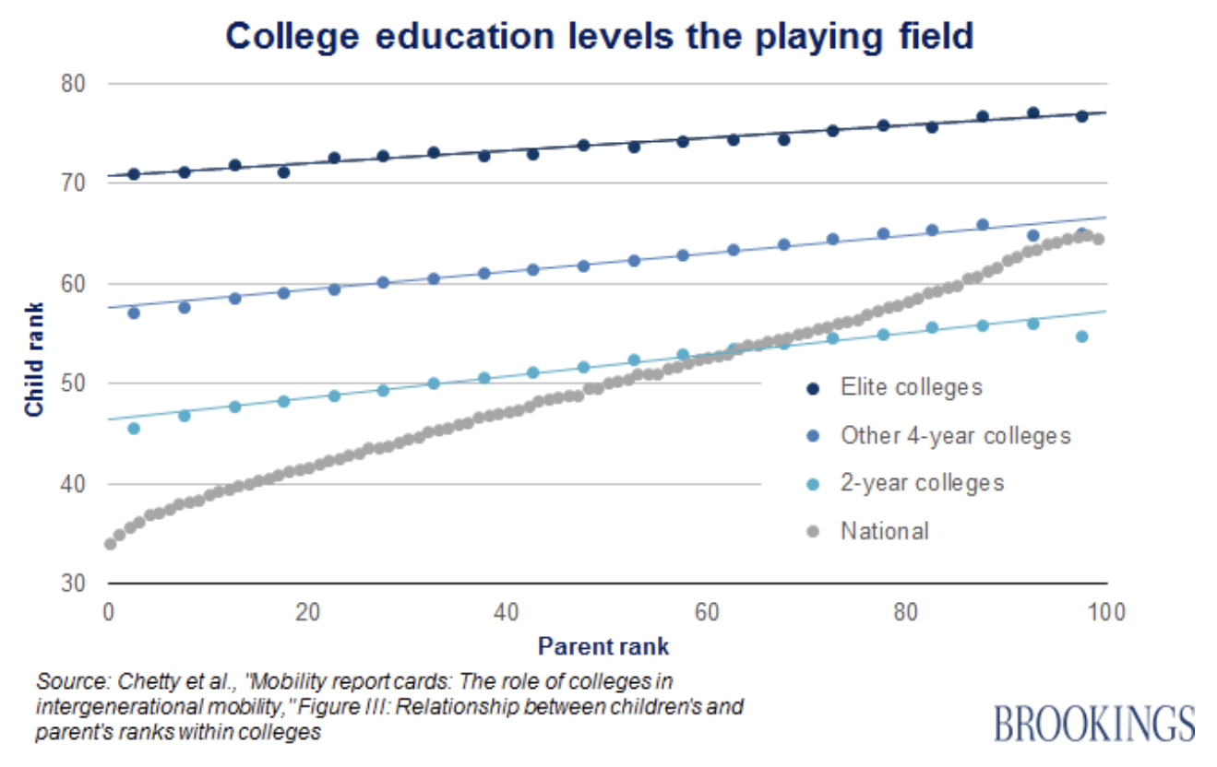
College

Slide 10
Drivers of polarization
Political: partisan sorting reflects economic and social drivers
Democrats | Republicans
Professionals Coasts and major cities Social movement identity groups Younger (49% under 50) | Small business Evangelicals Towns and rural areas Some socially conservative POC Older (42% under 50)

Slide 11
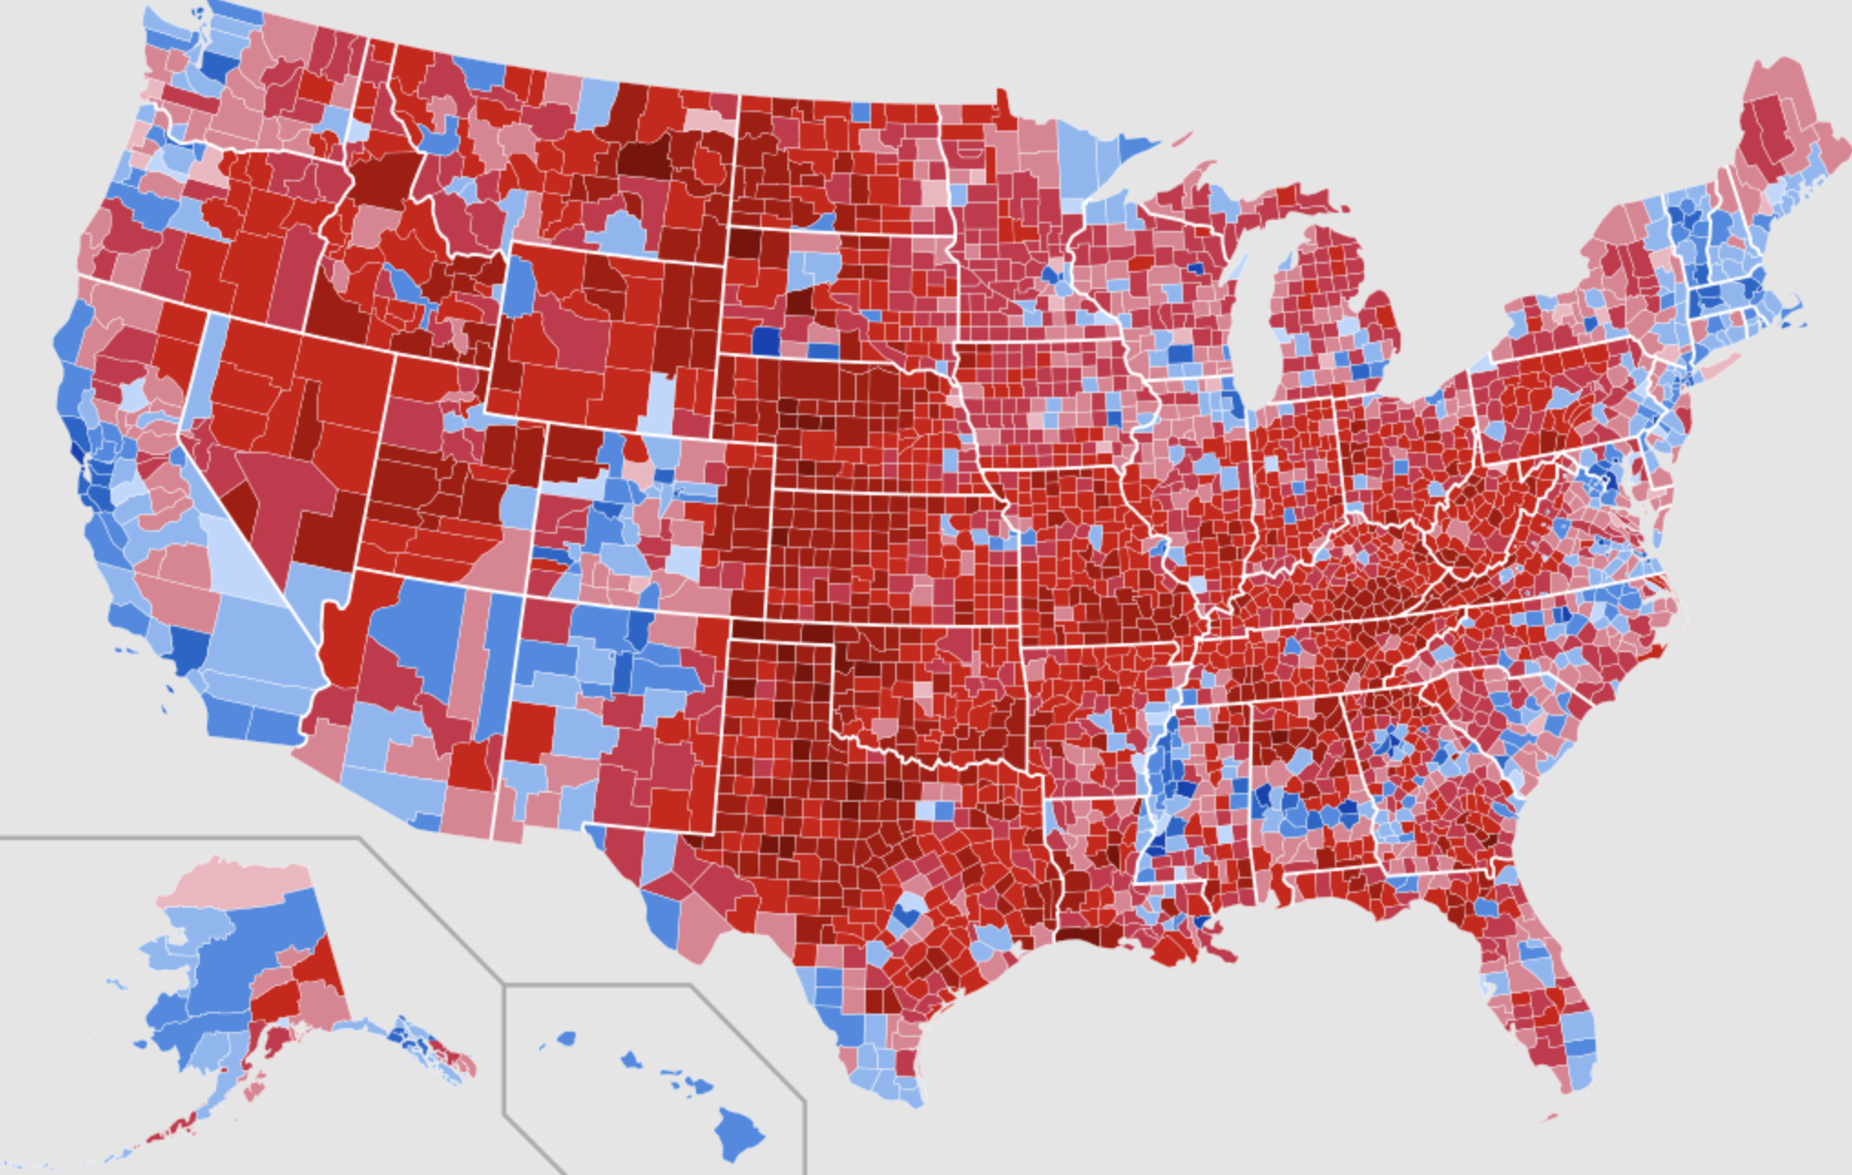
2020 vote for Biden & Trump by county

Slide 12
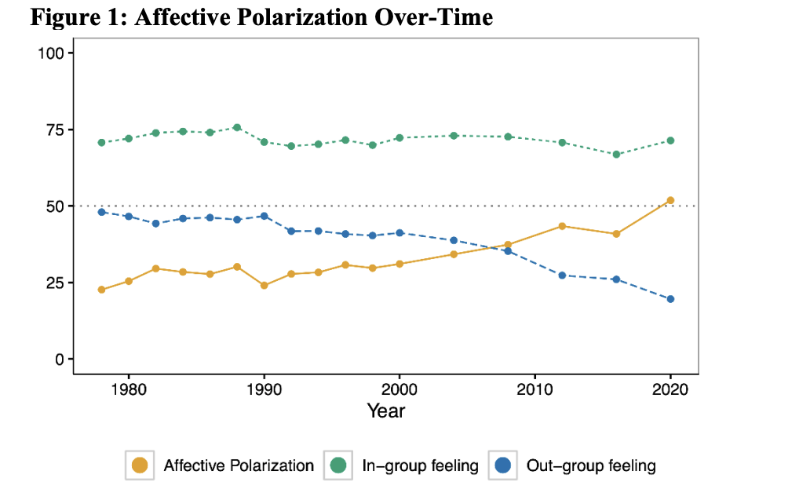
Where is the public now?
Druckman and Levy, “Affective Polarization in the American Public,” Northwestern U. IPR, 2021.
Notes:
While they hold a variety of views, the members of the Exhausted Majority are also united in important ways:
They are fed up with the polarization plaguing American government and society
They are often forgotten in the public discourse, overlooked because their voices are seldom heard
They are flexible in their views, willing to endorse different policies according to the precise situation rather than sticking ideologically to a single set of beliefs
They believe we can find common ground
Progressive Activists (8 percent of the population) are deeply concerned with issues concerning equity, fairness, and America's direction today. They tend to be more secular, cosmopolitan, and highly engaged with social media.
Traditional Liberals (11 percent of the population) tend to be cautious, rational, and idealistic. They value tolerance and compromise. They place great faith in institutions.
Passive Liberals (15 percent of the population) tend to feel isolated from their communities. They are insecure in their beliefs and try to avoid political conversations. They have a fatalistic view of politics and feel that the circumstances of their lives are beyond their control.
The Politically Disengaged (26 percent of the population) are untrusting, suspicious about external threats, conspiratorially minded, and pessimistic about progress. They tend to be patriotic yet detached from politics.
Moderates (15 percent of the population) are engaged in their communities, well informed, and civic-minded. Their faith is often an important part of their lives. They shy away from extremism of any sort.
Traditional Conservatives (19 percent of the population) tend to be religious, patriotic, and highly moralistic. They believe deeply in personal responsibility and self-reliance.
Devoted Conservatives (6 percent of the population) are deeply engaged with politics and hold strident, uncompromising views. They feel that America is embattled, and they perceive themselves as the last defenders of traditional values that are under threat.

Slide 13
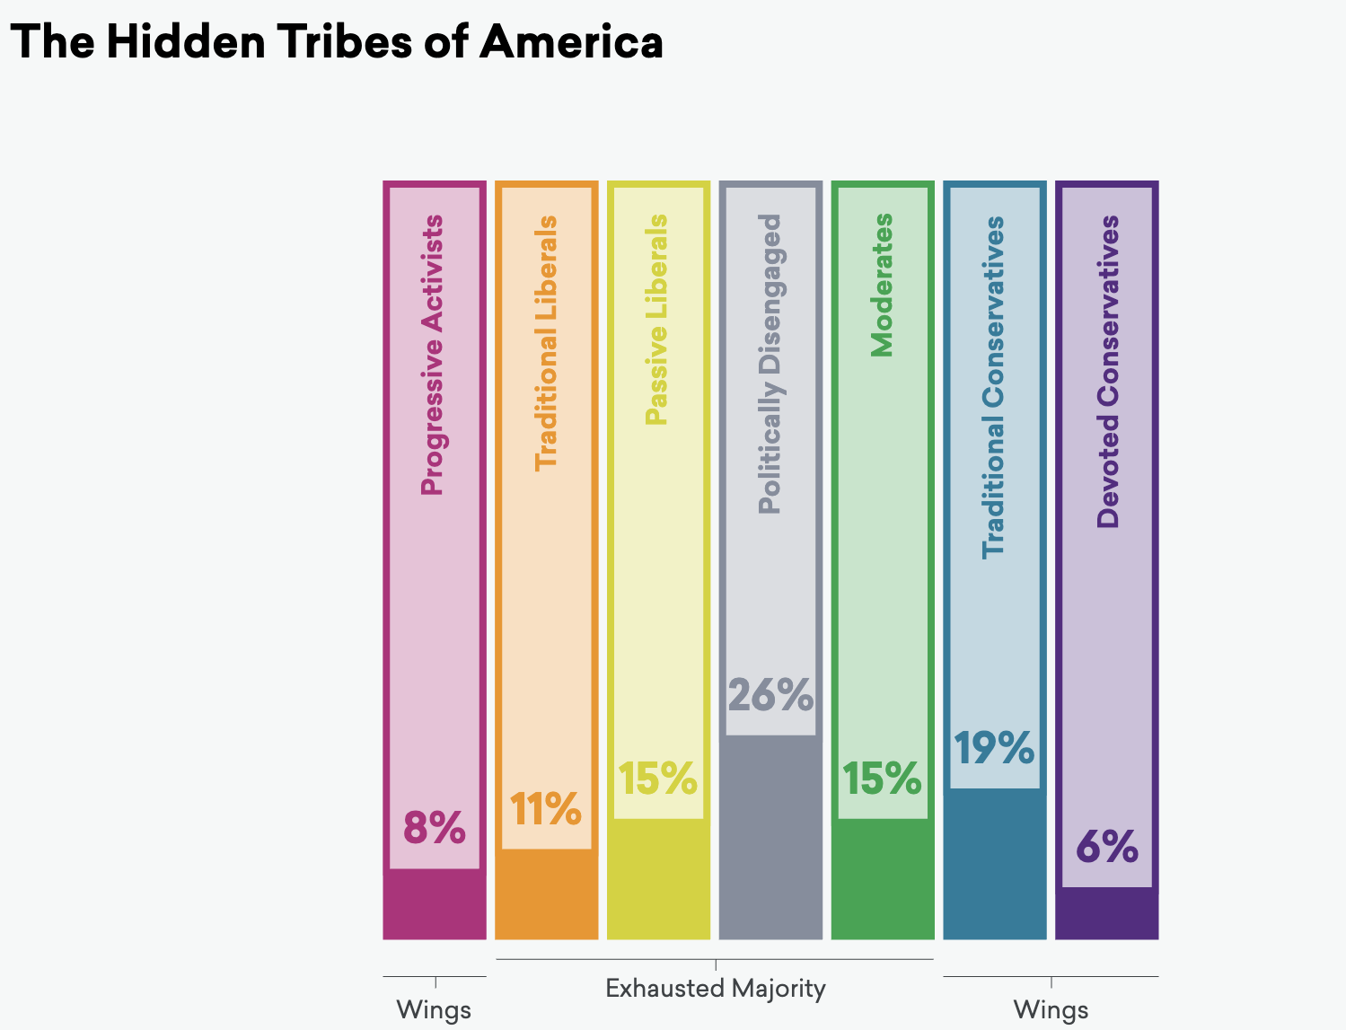
Where is the public now?
More in Common, The Hidden Tribes of America, 2019.
Notes:
While they hold a variety of views, the members of the Exhausted Majority are also united in important ways:
They are fed up with the polarization plaguing American government and society
They are often forgotten in the public discourse, overlooked because their voices are seldom heard
They are flexible in their views, willing to endorse different policies according to the precise situation rather than sticking ideologically to a single set of beliefs
They believe we can find common ground
Progressive Activists (8 percent of the population) are deeply concerned with issues concerning equity, fairness, and America's direction today. They tend to be more secular, cosmopolitan, and highly engaged with social media.
Traditional Liberals (11 percent of the population) tend to be cautious, rational, and idealistic. They value tolerance and compromise. They place great faith in institutions.
Passive Liberals (15 percent of the population) tend to feel isolated from their communities. They are insecure in their beliefs and try to avoid political conversations. They have a fatalistic view of politics and feel that the circumstances of their lives are beyond their control.
The Politically Disengaged (26 percent of the population) are untrusting, suspicious about external threats, conspiratorially minded, and pessimistic about progress. They tend to be patriotic yet detached from politics.
Moderates (15 percent of the population) are engaged in their communities, well informed, and civic-minded. Their faith is often an important part of their lives. They shy away from extremism of any sort.
Traditional Conservatives (19 percent of the population) tend to be religious, patriotic, and highly moralistic. They believe deeply in personal responsibility and self-reliance.
Devoted Conservatives (6 percent of the population) are deeply engaged with politics and hold strident, uncompromising views. They feel that America is embattled, and they perceive themselves as the last defenders of traditional values that are under threat.

Slide 14
From the Hidden Tribes Report
Members of the Exhausted Majority:
Fed up with the polarization plaguing American government and society
Often forgotten in the public discourse, overlooked because their voices are seldom heard
Flexible in their views, willing to endorse different policies according to the precise situation rather than sticking ideologically to a single set of beliefs
Believe we can find common ground

Slide 15
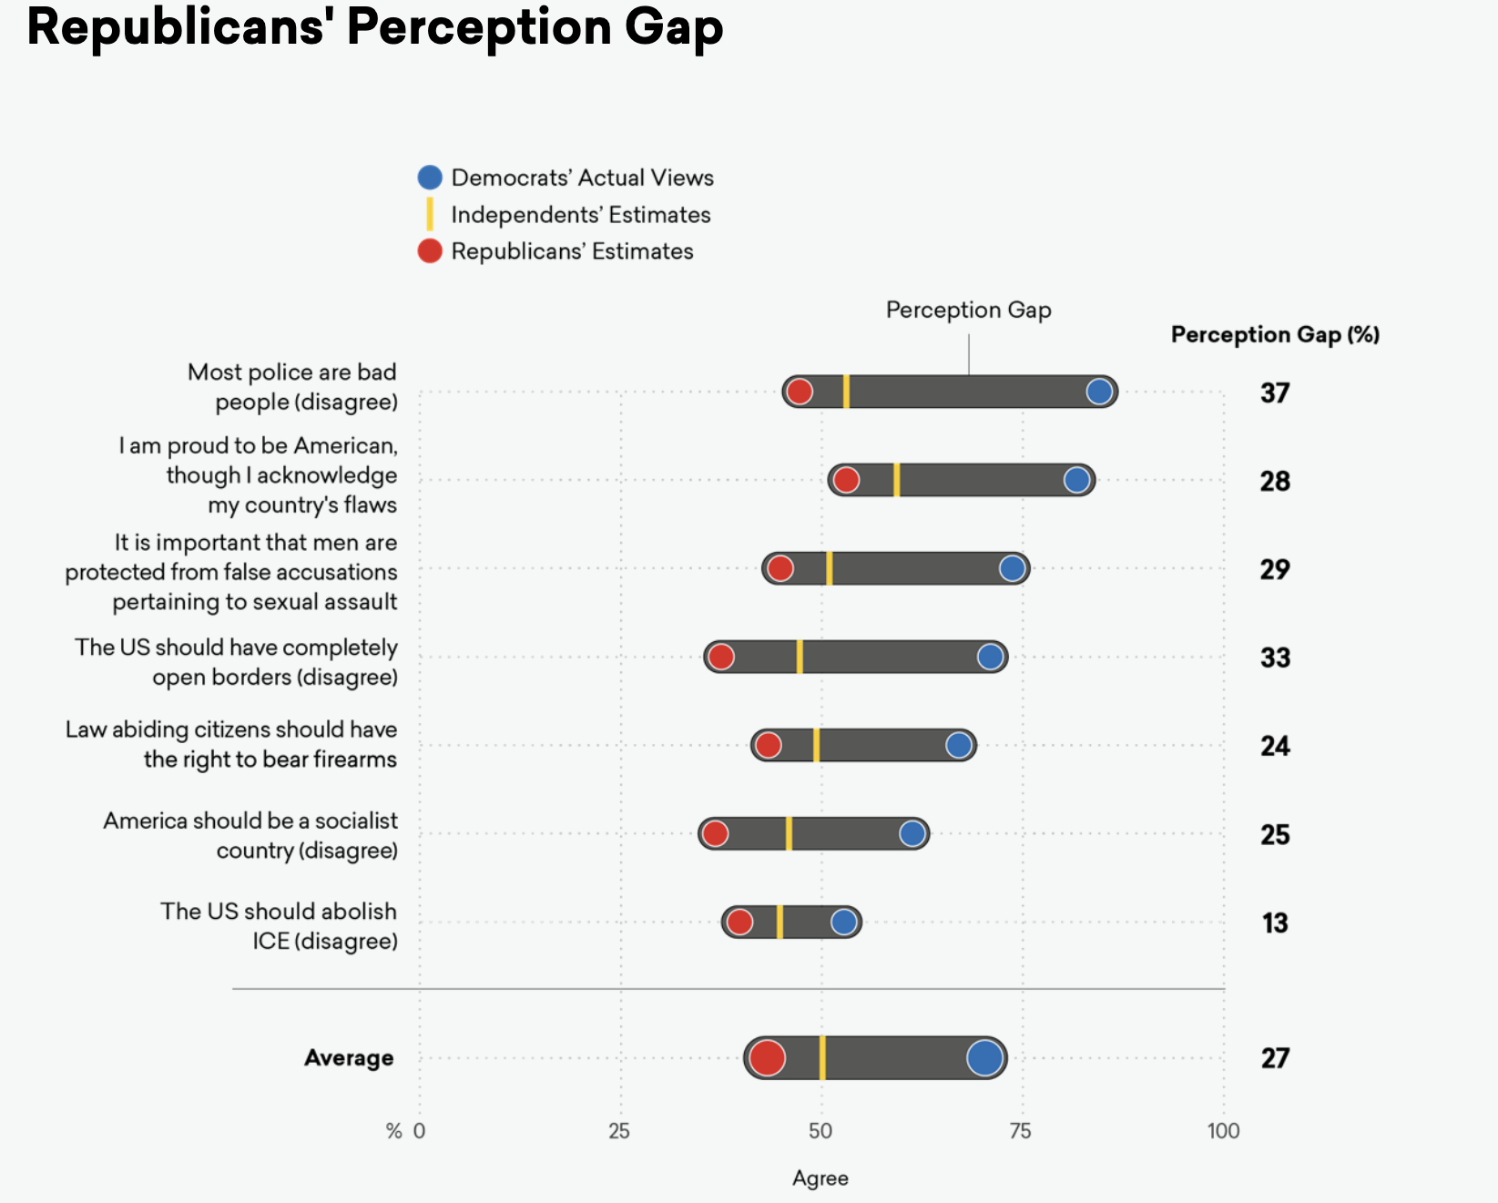
Rs get Ds wrong

Slide 16
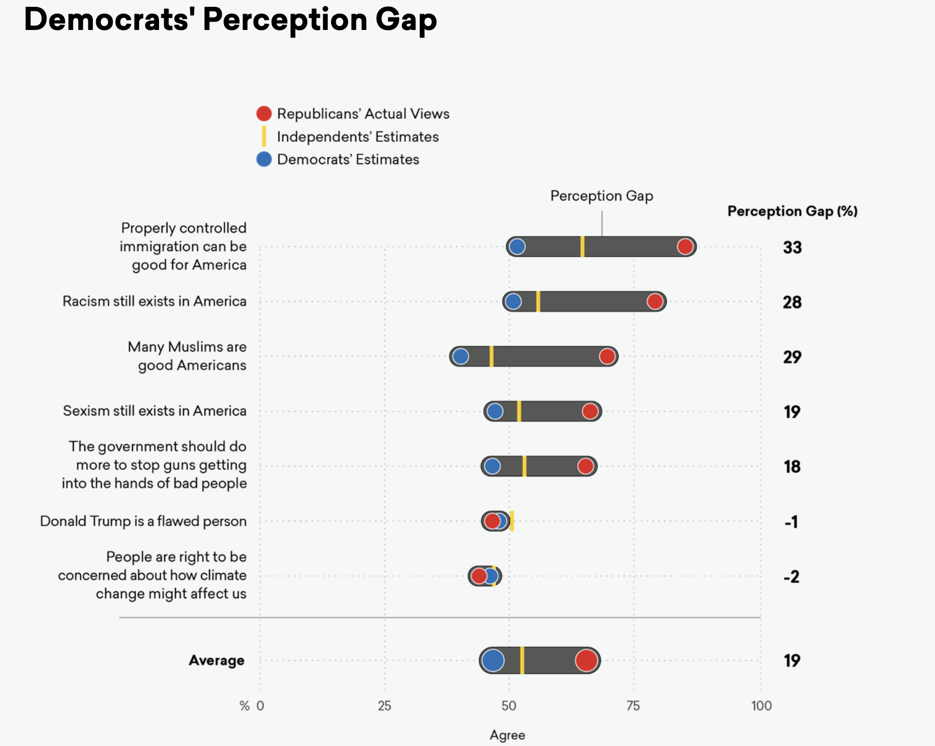
Ds get Rs wrong

Slide 17
How can we address the drivers of polarization?
Economic
Expanding economic opportunity and mobility
Reforming the news and information business
Social
Civic education
Civic culture: volunteering and community activities
Widening social networks (communities of place and virtual)
Dialogue across differences
Political
Electoral redistricting and elections
Congressional rules and culture

Slide 18
A few experiences with initiatives aimed at bridging major divisions
Economic:
Grand Bargain Project (CCD)
Support for Working Families Collaborative (Convergence)
Basic Income convening (The Institute)
Social
Bridging and Service convenings (CBI, Convergence, RBF)
Building the national bridging movement (Listen First Coalition and Bridging Movement Alignment Council)
Political
Commission on the Practice of Democratic Citizenship/More Perfect (AAAS)
Congressional dialogues after the events of Jan. 6th

Slide 19
A few reflections from experience
Interests still matter
Partisan identities are more often dominant
Connecting as people and building personal relationships is now essential for making progress on polarized issues
Everyone we work with wants to make the country better, and is willing to work with people with whom they disagree to get the job done

Slide 20
A framework for building consensus on polarized issues
Trust Building
Ground rules
Creativity
Reframing the problem
Negotiation
Joint Action
Socializing and relationship building
Perspective taking
Promise-deliver cycles
Joint fact finding
Interests, not positions
Facilitator modeling
Story telling and acknowledging history
Shared social and recreational experiences
Envisioning great outcomes/futures
Testing potential
Communicating about the group’s goals and work
Bringing in additional resources
Dealing with capacity gaps
Exploring and inventing without committing
Using diversity to foster divergent thinking
Multiple options
Wise trades
Fairness as a criterion
Mediation
Working with back tables
solutions
Notes:
Building from our core competence in the Mutual Gains Approach to negotiation, we have brought in expertise from many disciplines—group psychology and anthropology for trust building, performance and improvisation for creativity, communications and management for joint action—to help stakeholders move from impasse to collaboration.

Slide 21
What can mediators do?
As citizens: use our skills to help our communities have more constructive conversations (schools, affordable housing, policing, etc.)
Don’t have to wear the mediator hat
Reach out to local volunteers who are trying to help the conversation
As practitioners: some of us can take on formal roles as mediators and advisors on public issues
Better not to do it for the money…
As a professional community: our core values and principles are relevant to improving governance
Consider whether/when/how to speak as a community on the process being used to address polarized issues

Slide 22
A few resources
https://citizenconnect.us/
https://www.ncdd.org/
https://www.listenfirstproject.org/listen-first-coalition
https://www.joinmoreperfect.us/

Slide 23
Where do we go from here?
What do you see as the most important polarization challenges in our communities, and in our country?
What do you think needs to be done?
What do you think you, and we, can do to help?

